Slide 1

Stock Analysis
By
Kishore.PG

Slide 2
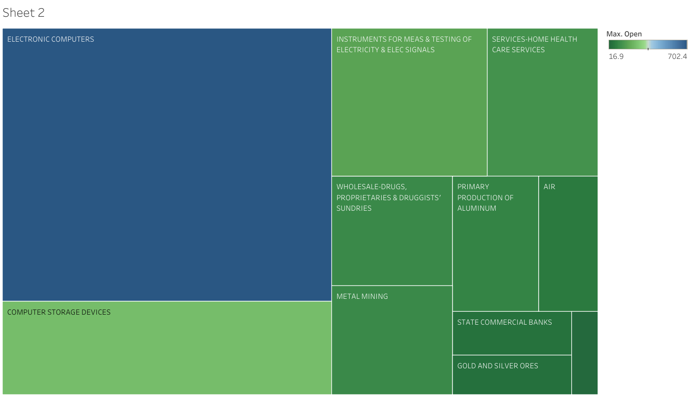
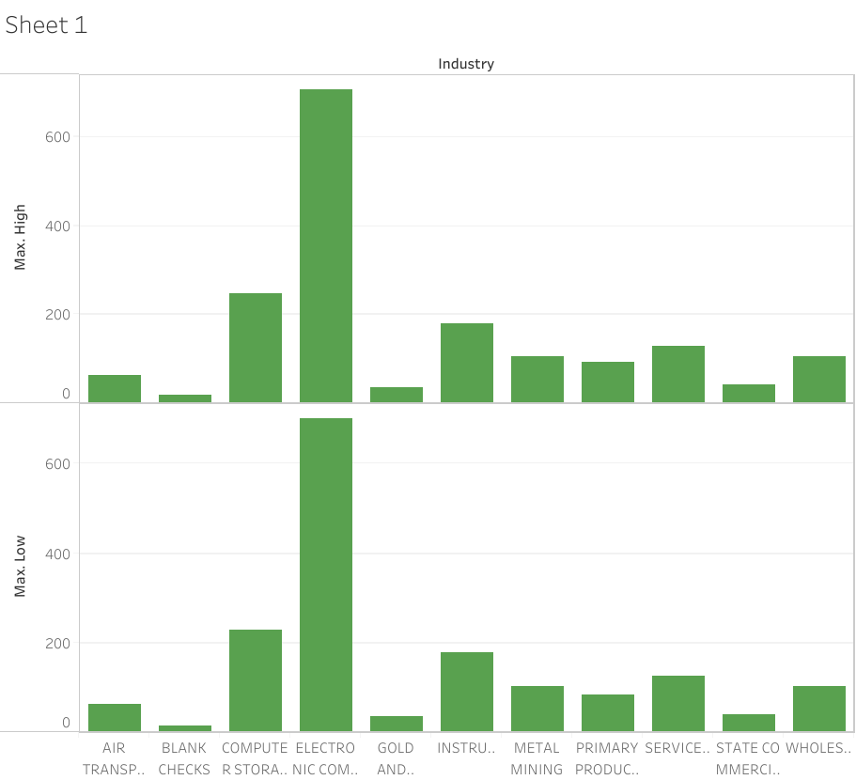
INDUSTRY WISE GROWTH RATE
Industry wise the maximum high and low stock rate were predominantly occurs on Electronic Computers and Computer Storage devices.
This will help us to focus on what kind of industry we can choose for investment

Slide 3
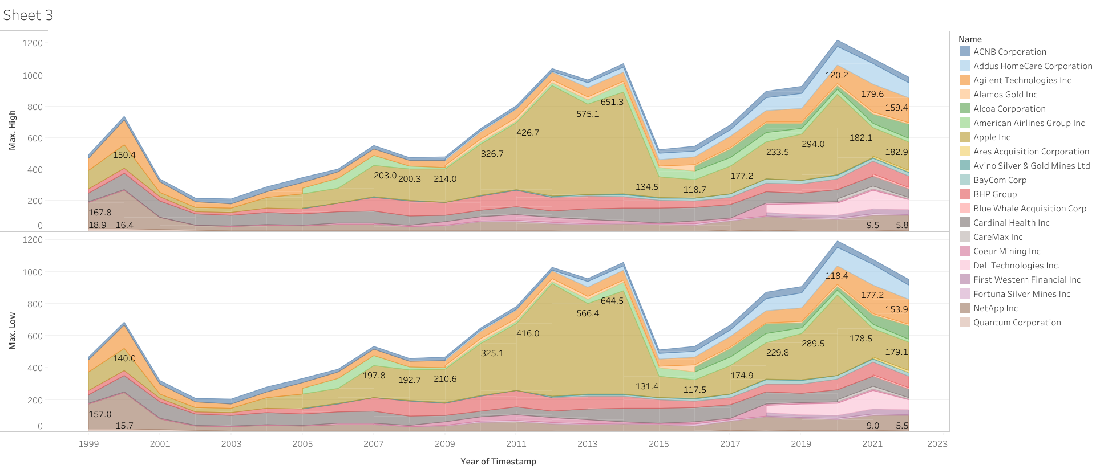
COMPANY TRADE W.R.T YEAR (HIGH AND LOW)
In the last 10 years ACNB Corporation, Addus Homecare Corporation and Agilent Technologies
are the three companies which has reached peak value and we can expect in the coming years it is good for us to invest in.

Slide 4
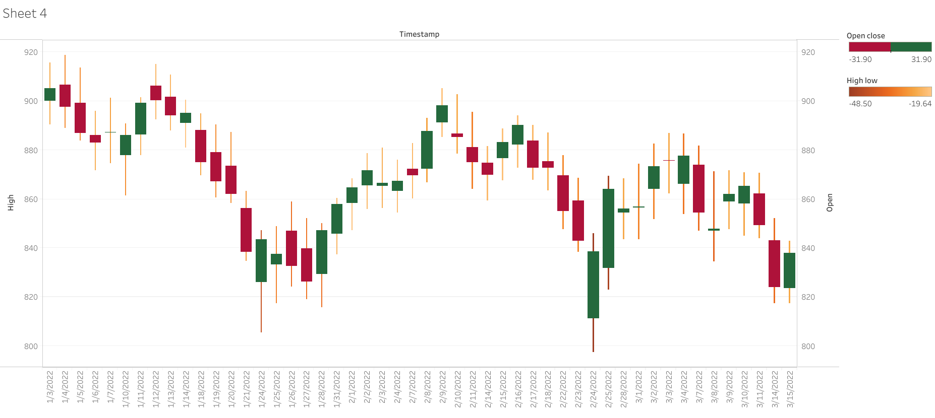
FLUCTUATION RATE (LAST 3 MONTHS)
This Gantt Bar is used to represent the daily fluctuation rate in the last three months it will help us to invest on daily basis.
If the closing value is high then it is good for us to sell that particular share

Slide 5
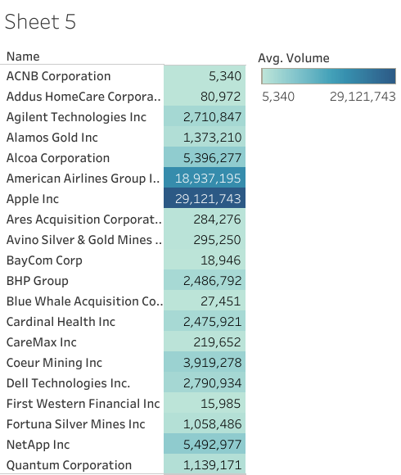
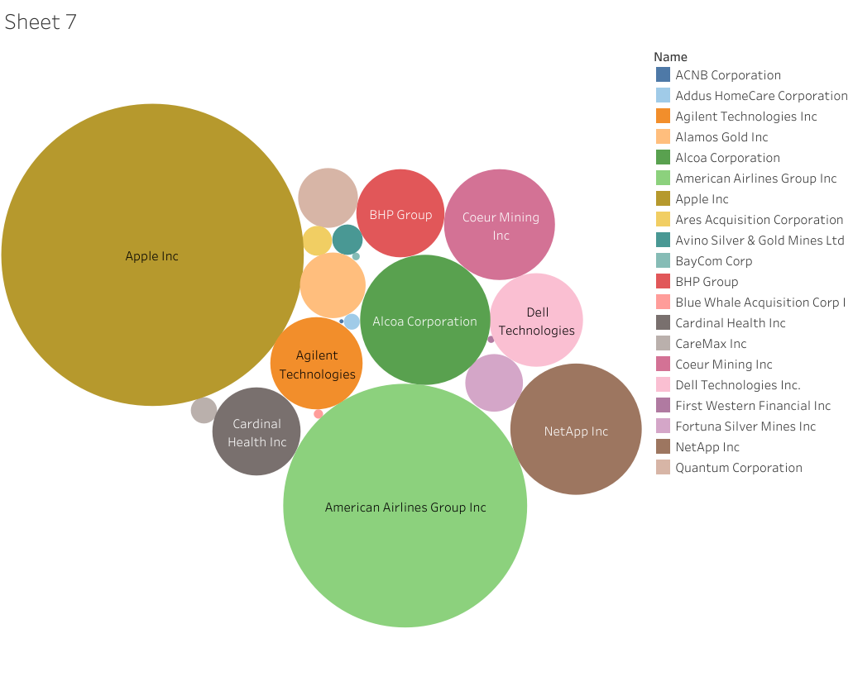
COMPANY’S AVERAGE VOLUME
Here with the help of packed bubbles chart I have found the overall average volume of each company.
From the above it is clearly shows that Apple and American Airlines are the two companies which has high amount of volume.
So these are the standard companies in which we can invest blindly so that stock rate will always be in moderate condition.

Slide 6
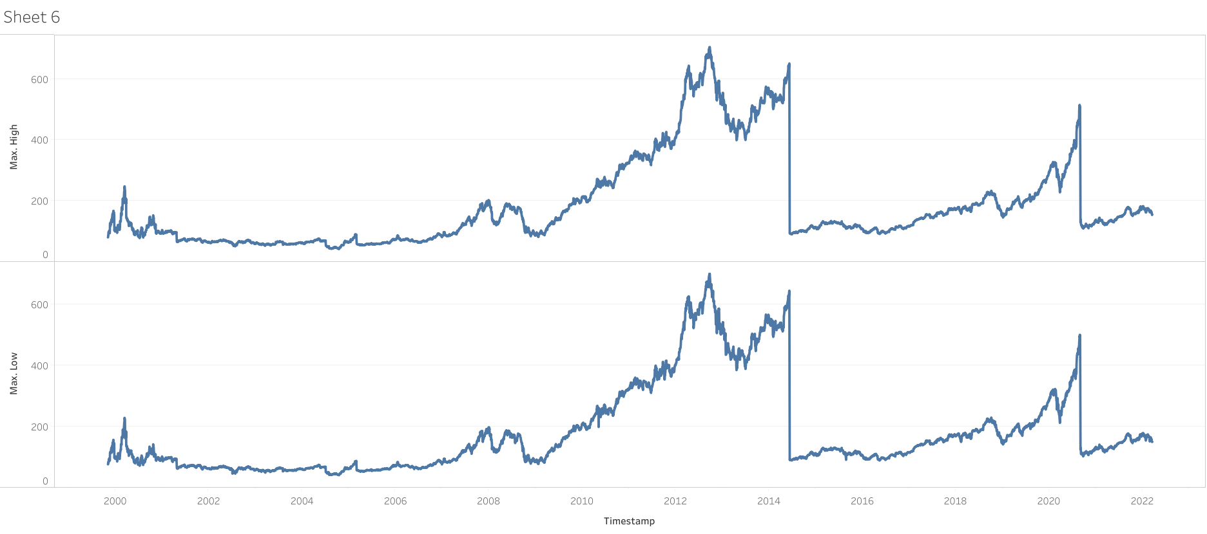
DAY WISE FLUCTUATION RATE
The above represents the overall stock rate fluctuation on daily basis over the years.
In the year 2014 to 2016 the market value was good.
But in the year 2022 the market was down so we need to wait for ramping up to its peak.

Slide 7
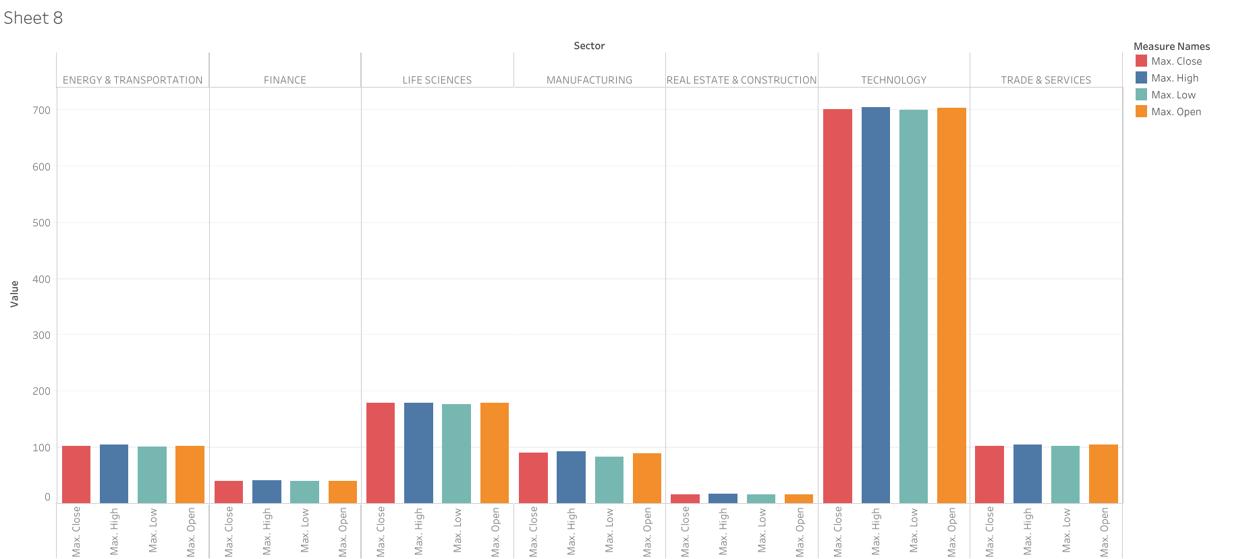
SECTOR BASED TRADE
Sector plays a vital role in stock market in what kind of sector we are investing based on that we can gain profit.
Technology sector right now in peak condition although market down if we invest in technology we can gain minimal profit

Slide 8
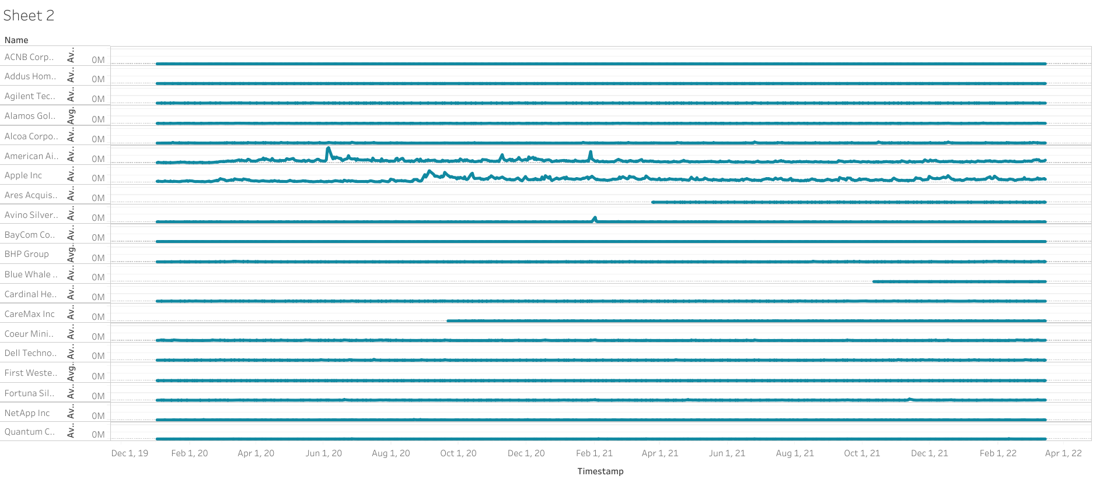
LAST 3 YEARS TRADE OF EACH COMPANIES
Based on last 3 year comparison although market is down if we invest Apple and American Airlines we can expect some gains as these are the standard companies.

Slide 9
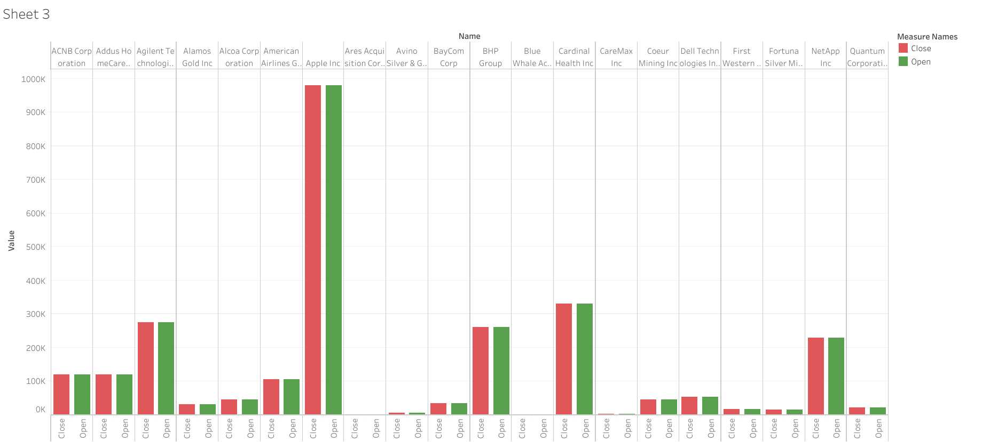
DAY TO DAY STOCK ANALYSIS(OPEN & CLOSE)
This analysis is for daily routine and also we can check hourly basis as well.
Apple, Cardinal Health and Agilent technology are the companies in which we can invest on regular basis
because these companies opens their stock value on regular interval.

Slide 10
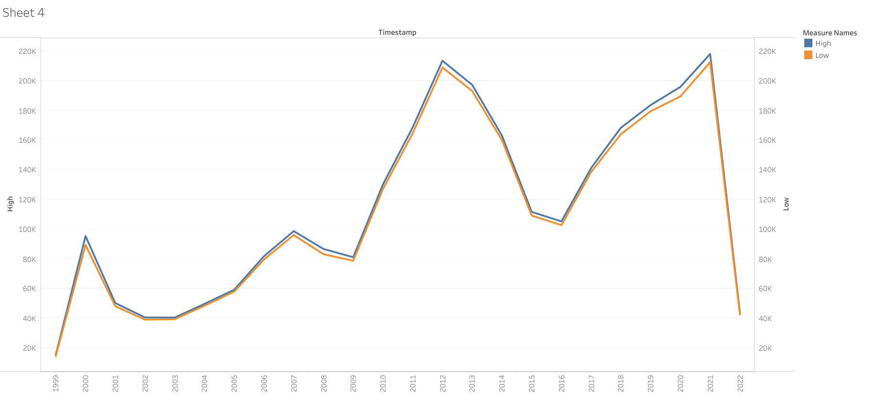
OVERALL STOCK RATE FLUCTUATION OVER THE YEARS
This is the conclusion analysis which I did as the graph shows in the year 2012 the market was at its peak.
But right now the situation was too worse because the market value is dropping off day by day.
So its good to invest only standard companies so that we cant experience any loss

Slide 11

Thank you

